Slide 1
Eye-Ternet ®
USER MANUAL

Slide 2
1. Positioning
Open the wrapping
Bring out the lens and water-flask
Spray the water on the lens at each utilisation
Put it on your eye

Slide 3
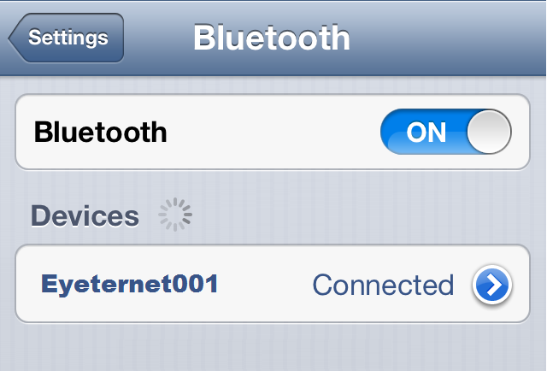
2. Setting
- BLUETOOTH
Make 2 winks to start the lens
Switch on the Bluetooth (On your Smartphone)
Select “EyeternetXXX” (XXX will are numbers)
A small window appears
Accept the asking bluetooth

Slide 4
2. Setting
- INTERNET
Must have Internet on your Smartphone for the Eyeternet’s updates
Switch on the Internet tethering
You have now Internet to make the Eyeternet’s updates

Slide 5
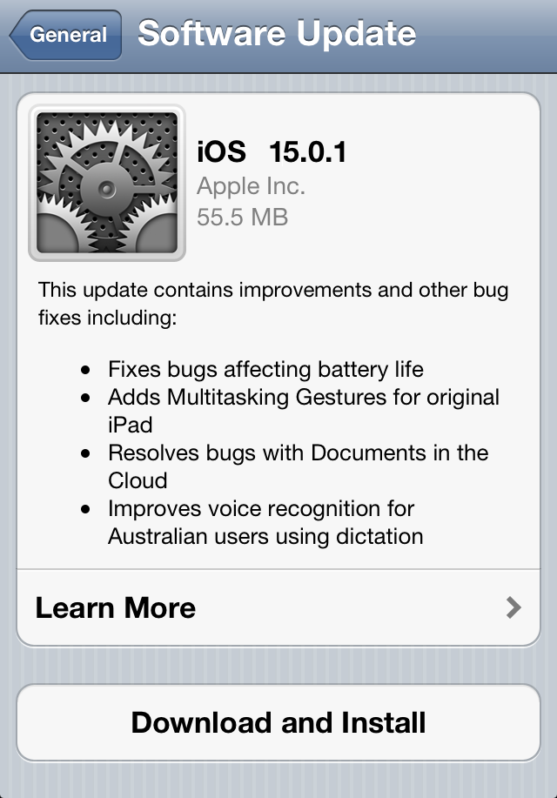
2. Setting
- EYETERNET’S UPDATES
Go in the settings on the lens
Update the system
Wait for around 30 minutes
Switch off the lens

Slide 6
3. USE
- WARNING
Use less than 5 hours a day
Don’t go in water with it
Don’t sleep with it
Switch off before take it out of your eye.
Don’t use 2 Eyeternet

Slide 7
Enjoy it !
Find our other product on https://www.apple.com/fr/

